Slide 1

Enhancing Search Engine Relevance for Video Subtitles
Tamilarasan A

Slide 2

Introduction :
In today's digital era, search engines are vital for accessing relevant content efficiently.
This project focuses on enhancing search engine relevance specifically for video subtitles, aiming to improve user experience and content accessibility.
By leveraging natural language processing and machine learning techniques, our objective is to develop an advanced search algorithm that delivers accurate and meaningful results for video subtitle queries.

Slide 3
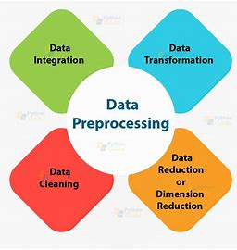
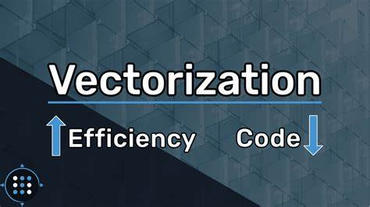

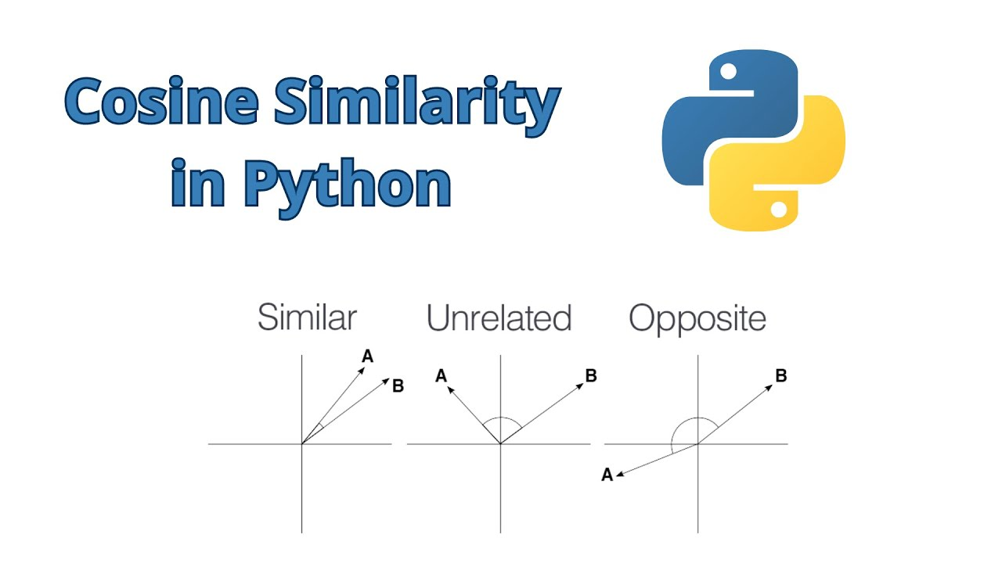
Core Logic :
Data Preprocessing : Clean text data (e.g., remove timestamps) crucial for vectorization.
Vectorization : Vectorize subtitle documents and user queries.
Cosine Similarity : Calculate cosine similarity between document and query vectors.
Result Retrieval : Return most similar documents based on similarity scores.

Slide 4
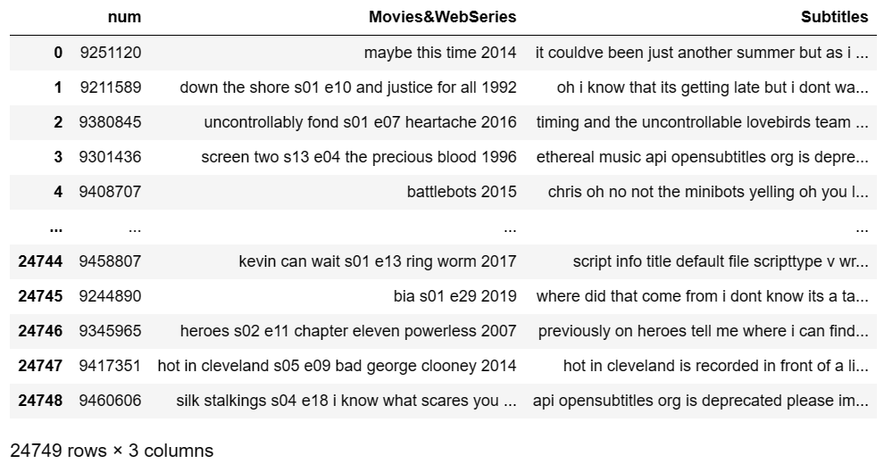
Data Processing :
Read data from database tables using Python.
Handle ZIP files with Latin-1 encoding.
Data Operations:
Clean data: remove timestamps, leading characters, symbols, numbers, and tags.
Select 30% of the data.
Result:
Show cleaned and processed data.

Slide 5
Text Vector Generation :
BOW/TFIDF for keyword search.
BERT-based SentenceTransformers for semantic search.
Document Chunker :
Handling large documents.
Mitigating information loss with overlapping windows.
Embedding Storage in ChromaDB :
Efficient storage and retrieval.

Slide 6
Retrieving Documents :
Take the user's search query.
Preprocess the query (if required).
Create query embedding.
Using cosine distance, calculate the similarity score between embeddings of documents and user search query embedding.
These cosine similarity scores will help in returning the most relevant candidate documents as per user’s search query.

Slide 7
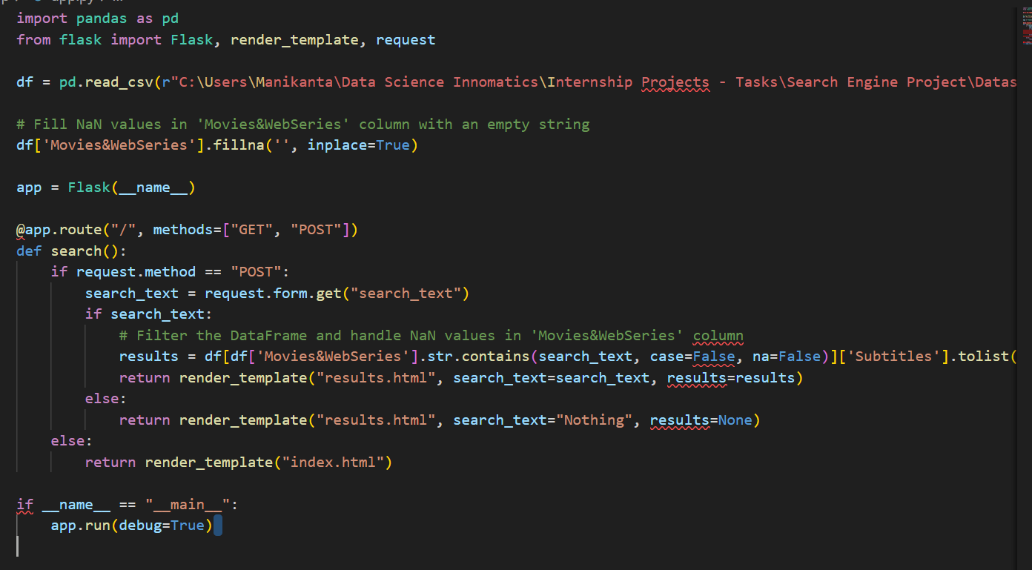
The code is for a Flask app that acts as a movie subtitle search engine.
It reads data from a CSV file into a Pandas DataFrame, handles user search queries, and displays results using HTML templates with CSS styling.

Slide 8
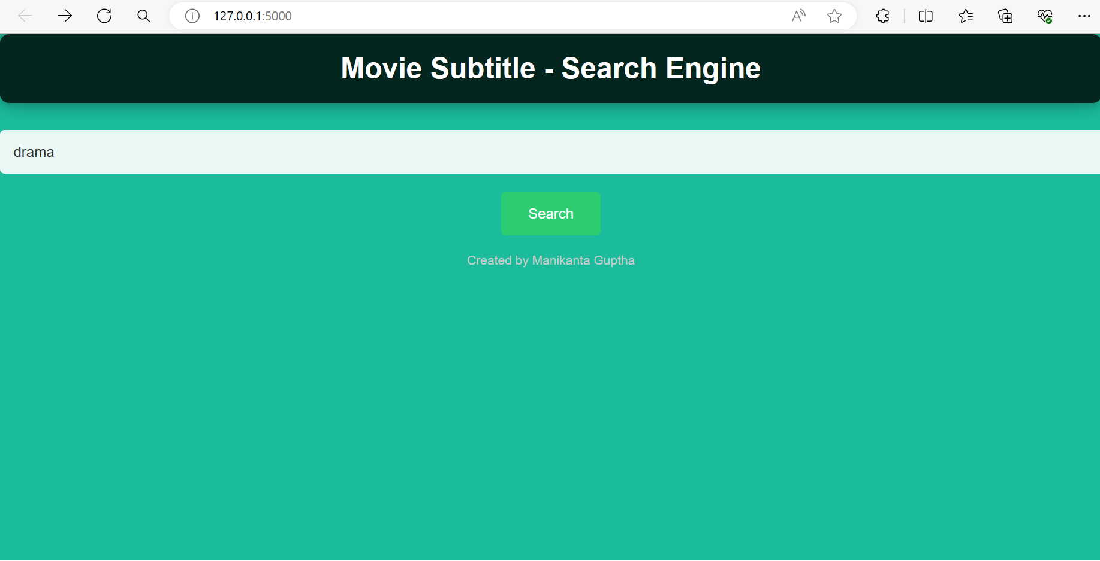
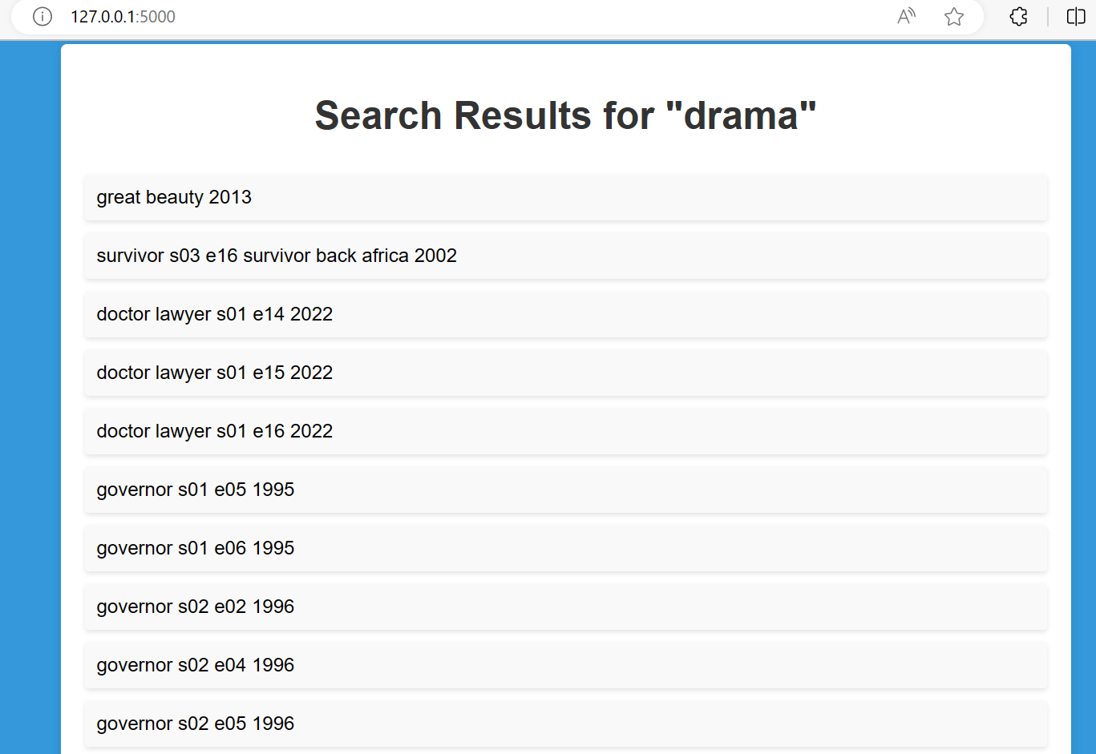
Output Result :
The code creates a web app where users can search for movie subtitles.
The results are displayed on a page styled with specific colors and layout

Slide 9
Conclusion :
Summary of project objectives and methodology.
Impact : Improved search relevance for video subtitles.
Future Directions : Potential enhancements or extensions.
This project aims to enhance search engine relevance for video subtitles, employing advanced techniques like semantic understanding and efficient document processing.

Slide 10


